Slide 1
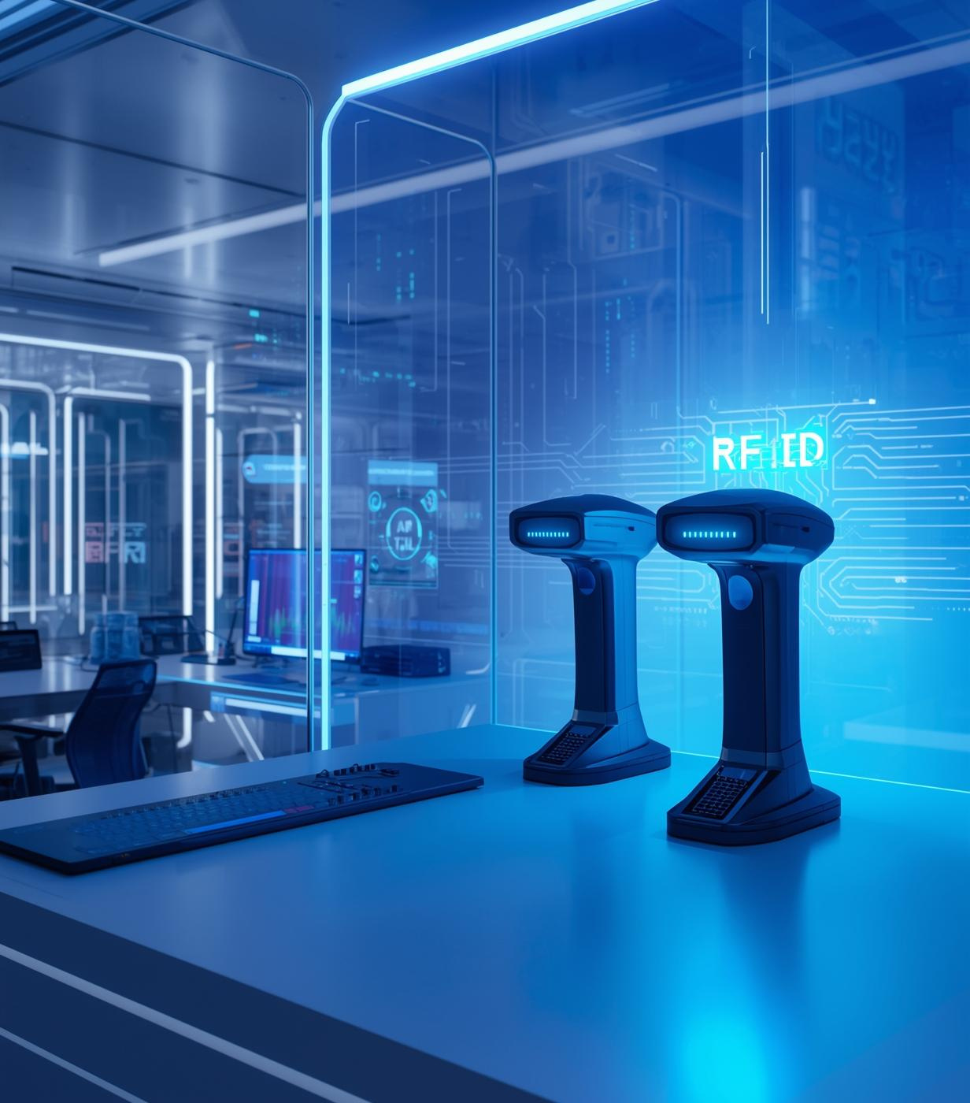
RFID Attendance: The Future of Presence
Titiksha Gupta – 24DEC023
Arush Dakhera – 24DEC045

Slide 2
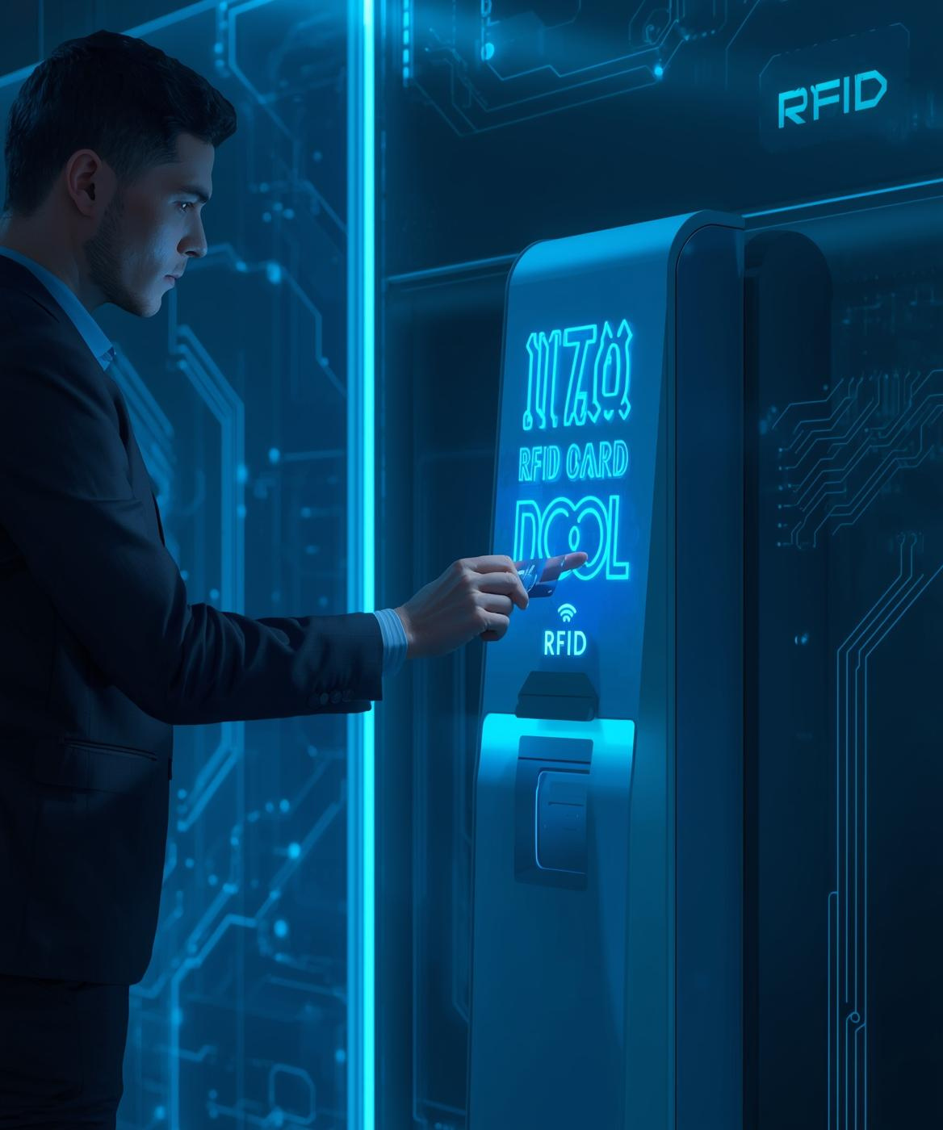

Introducing the RFID System
RFID-based attendance system automates traditional roll-calling by using contactless RFID cards.
It enables:
Fast & accurate attendance
Eliminates manual errors
Prevents proxy attendance
Logs data instantly using microcontroller + LCD + buzzer confirmation
RFID uses radio waves to read a unique UID from each card, making it ideal for institutions requiring speed + accuracy.

Slide 3
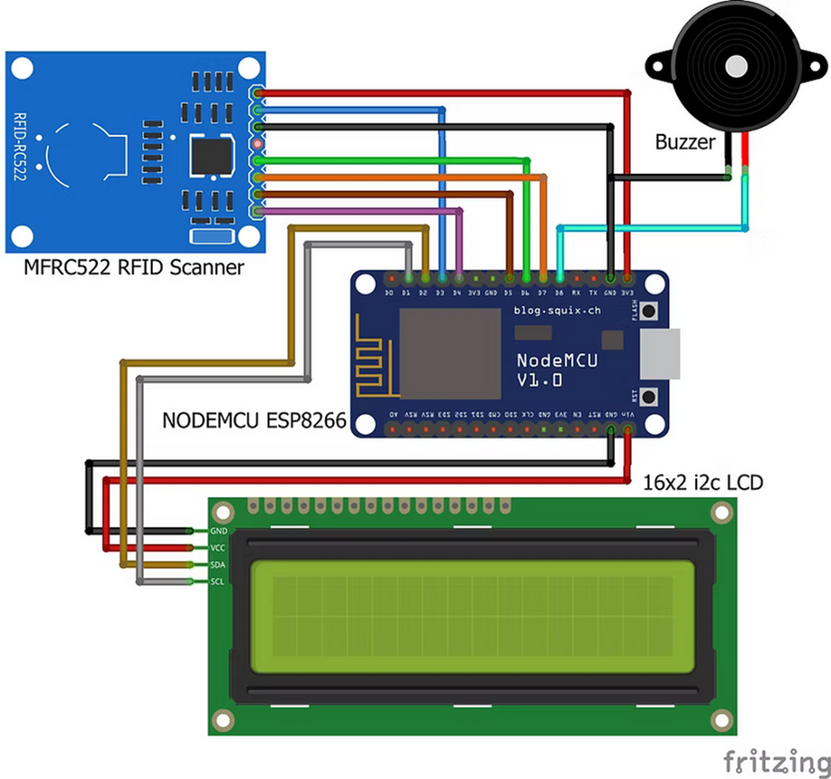
System Working & Architecture
Components Used
•ESP8266(NODEMCU)
•RFID READER (RC522)
•RFID TAGS/CARDS
•16X2 LCD DISPLAY
•BUZZER + LEDS
•JUMPER WIRES + BREADBOARD
RFID enables unique, contactless identification → fast, secure, automated attendance marking.
Features:
RFID Tag → RC522 → NodeMCU → LCD + Buzzer → Google Sheet

Slide 4
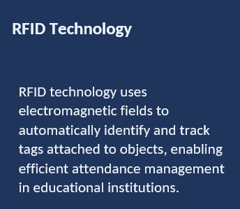
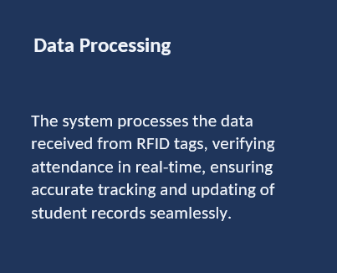
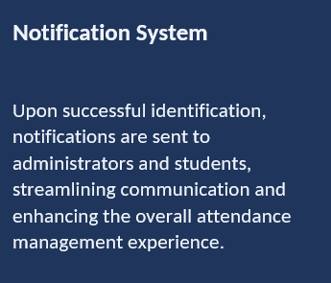
Working Principle

Slide 5
Implementation Roadmap
RFID-based attendance systems are widely used across different sectors due to their speed, accuracy, and ease of automation. They simplify attendance tracking, reduce manual effort, and provide secure identification, making them suitable for educational institutions, offices, research facilities, and access-controlled environments.
Applications
Schools, colleges, and training centers
Corporate offices & IT workplaces
Laboratories, libraries, hostels
Gyms, clubs, and membership areas
Event entry & secure access monitoring
Future Scope
Cloud dashboards for real-time analytics
Mobile app-based alerts & tracking
Biometric + RFID dual verification
Long-range RFID for automatic entry
Integration with ERP/databases
Face recognition + RFID hybrid security

Slide 6
Observations
The RFID-based attendance system provides a fast, reliable, and automated method for recording attendance.
It eliminates manual errors, prevents proxy, and improves workflow
System works smoothly when WiFi is connected
LCD displays name instantly
Buzzer gives confirmation
RFID read accuracy is high
Strengths: Fast, contactless, accurate
Weaknesses: Short range, card damage risk
Opportunities: Expand to labs, hostel, hybrid systems
Threats: RFID cloning, hardware failure

Slide 7
Conclusion
The RFID-based attendance system provides a fast, reliable, and automated method for recording attendance.
It eliminates manual errors, prevents proxy, and improves workflow efficiency.
The system is:
Cost-effective
Scalable
Easy to implement
Suitable for institutions and offices
Future upgrades: mobile app notifications, cloud dashboards, biometric-RFID hybrid.

